Slide 1
Creighton University
OMB Uniform Guidance Implementation for Principal Investigators
Paul Tomoser – Internal Audit Director
Beth Herr – Sponsored Programs Director Amber Purdy Vogel – Grants Accounting
Ye Zheng – Grans Accounting

Slide 2
So what is this all about?
Creighton is a recipient of over $20 million in federal awards annually
The US Office of Management and Budget (OMB) issued broad revisions to its guidance for new awards and additional funding to existing awards effective December 26, 2014
2CFR Chapter I and II Parts 200, 215, 220, 225 and 230 Uniform Administrative Requirements, Cost Principles, and Audit Requirements for Federal Awards (UG)
UG streamlined and consolidated existing OMB documents and regulations into one document
2

Slide 3
What we’ve done
A core team worked to manage the Uniform Guidance Implementation (UGI) Project (i.e. policy development and revisions)
A preliminary assessment matrix was developed by Internal Audit to determine impacts and gaps, prioritize efforts, and organize work teams
Huron Consulting was engaged to provide support and technical expertise and was on site January 15 – 16, 2015 to facilitate discussions and assist the work teams
3

Slide 4
Where we are now…….
Work teams have reviewed and revised policies in accordance with Huron guidance
Policies have been updated on Accounting Services and VP of Research and Scholarship websites
Four key areas have been completed in order to stay in compliance with the new UG rules:
Cost Principles Financial Monitoring Property Subrecipient Monitoring
Three areas have been delayed:
Performance Management and COI in Research, Procurement (implementing FY 18)
4

Slide 5
Let’s Start with the Basics.
What Do I have to consider when I want to charge something to a sponsored project?
Allowable
Reasonable
Allocable
Consistently Treated
5

Slide 6
How Do I Know what is Allowable?
Costs must conform to
Any limitations or exclusions in the cost principles 2 CFR section 200.400
The award’s terms and conditions
University Policy
6

Slide 7
A partial listing of UNALLOWABLE costs
Entertainment costs
Tickets to a sporting event
Movies in a hotel room
Alcohol
Bad debts
Alumni Activities
Losses from other awards
7

Slide 8
In summary
Expenses charged to a sponsored project must benefit that project directly to be allowable.
8

Slide 9
How Do I Know What is Reasonable?
Prudent Person Test- What would a reasonable person do in a similar situation?
Necessary for the Project
Adhere to laws and regulations
Newspaper Test!!!
9

Slide 10
What does Allocable Mean?
Goods or services involved are charged in accordance with the relative benefits received
Costs that benefit more than one project and can be split based on benefit to each
For example, cost of a piece of machinery could be split based on time spent on each project
Example of not allocable- lab coats
Absolutely NO shifting of costs from one project to another to cover cost overruns, avoid restrictions or for convenience!!!!
10

Slide 11
What does Consistent Treatment Mean?
“A cost may not be assigned to a Federal award as a direct cost if any other cost incurred for the same purpose in like circumstance has been allocated to a Federal Award as an indirect cost.”
Appendix I lists all of our account codes and whether this type of expense can be charged directly or is it to be covered by the indirect rate.
Appendix I is on Dr. Murray’s website under Grants Accounting Tab
11

Slide 12
Direct Vs Indirect Charges
Total Expenses charged to the grant =
Direct + Indirect
Direct Charges are charges that can be identified specifically with that sponsored project.
An Indirect charge is automatically posted by Banner to account 7890 each time a direct expense is charged.
The indirect calculation is based on the indirect rate stated in the contract. For Federal awards, this rate is 45.5%
12

Slide 13
Indirect Charges – An Example
If a lab supply is charged to a sponsored project for $100, Banner calculates $45.50 and charges this amount to the sponsored project under account 7890.
The total amount charged to the sponsor for this entire transaction will be $145.50.
13

Slide 14
Indirect Charges – What’s Covered by that 45.5%?
Administrative salaries – such as most administrators’ salaries, pre award, post award salaries and expenses
General Office Supplies
Utilities
General maintenance and repairs
Interest
Academic Expenses
14

Slide 15
Overview of Changes for Financial Monitoring-
15

Slide 16
Overview of Changes for Financial Monitoring-
The backbone of the new guidance is internal control.
The granting agencies expect us to have good internal controls, including adequate monitoring procedures
We are starting to develop some metrics and if spending is outside of these, we may ask questions (no spending on salaries for first two months, overages on certain budget lines)
16

Slide 17
Overview of Changes for Financial Monitoring- Monthly Reports
PI’s and Admins should be reviewing their grants on a monthly basis.
At least quarterly, a PI and Admin should meet and review the new Quarterly Grant Review Form to ensure the PI knows the spending, availability and personnel currently charged to each grant.
17

Slide 18
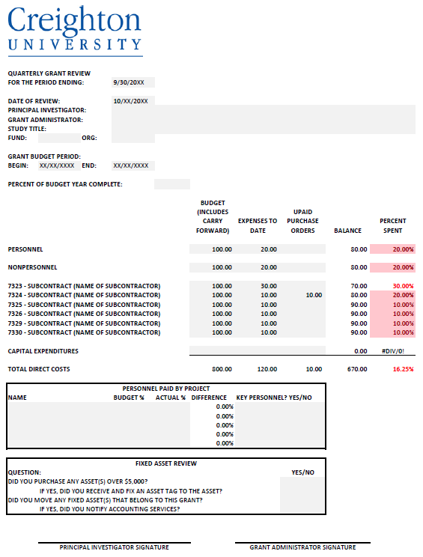

Slide 19
Overview of Changes for Financial Monitoring – Cost Transfers and Effort Recertification
Due to increased risk in late cost transfers (over 90 days after original transaction) and in the event we need effort recertification (changing effort after certified once), we developed a new form called “Over 90 Days Cost Transfer or Salary Recertification Form”
Completed by PI
Signed by Chair and AVP of Research & Scholarship
We don’t have a lot of these to start with, but they are very high risk, so we need to escalate the approval for these.
19

Slide 20
Overview of Changes for Financial Monitoring – Other Effort Reporting changes
Stricter deadlines for PARs- another high risk area- new escalation
Not received by Acct Services in 30 days
Notify PI and Dept Admin
Not received by Acct Services in 60 days
Notify Dept chair
Not received by Acct Services in 90 days
Notify Dean and Research Compliance Committee
Not received by Acct Services in 120 days
Salary will be moved off grant and charged to dept
20

Slide 21
Financial Monitoring – Effort Reporting
Levels of effort proposed in any sponsored project application should be consistent with the actual effort each individual is expected to expend on the project.
Sponsors generally consider proposed effort in the grant proposal to be the commitment, if the proposal is awarded.
PI’s and other key personnel are responsible for ensuring that these commitments are met.
21

Slide 22
Financial Monitoring – Effort Reporting
Principal Investigators and other key personnel named in the award may not reduce their effort by more than 25% of the amount committed – or be disengaged from the project for more than three months without notifying and requesting approval from the sponsor.
Some awards may not allow any reductions in effort from the commitment.
22

Slide 23
Overview of Changes for Financial Monitoring- Closeout
The government is changing the timeframe for drawing our money. It is shorter with no wiggle room
All allowable transactions need to be posted to ledger in 45 days after end date
PI and administrator will receive a final “Grant Reconciliation Worksheet”
Acct Services needs approval in 7 days
23

Slide 24
Overview of Changes for Equipment- Maintenance and Use
24

Slide 25
Overview of Changes for Equipment- Maintenance and Use
PI is responsible to make sure equipment is maintained and kept in good working order
Must use equipment for authorized purposes until funding for the project ceases or until the property is no longer needed for the project
Priority after that:
Activities under same agency
Activities under other federal awards
Activities for general university projects
25

Slide 26
Overview of Changes for Equipment- Disposal
When equipment acquired under a Federal award is no longer needed, if Fair Mkt Value is over $5,000 disposition instructions must be requested from the agency
If equipment is to be sold, we have to remit all but lower of 10% or $500 to the government
If equipment has a value under $5,000, we can sell with no further obligation
Must follow Doit policies on computer recycling
26

Slide 27
Overview of Changes for Equipment- PI’s Coming To or Leaving Creighton
If PI brings equipment - Accounting Services needs a listing of that equipment so we can get it on the books
If PI is leaving and taking equipment with him/her,
Work with sponsored programs to obtain University and agency approval prior to moving
Asset Disposal/Move Form must be completed including approval from dean.
27

Slide 28
Overview of Changes for Subrecipient Monitoring
28

Slide 29
Overview of Changes for Subrecipient Monitoring
Need to do a risk assessment and based on that assessment, we may need to do more procedures
New Form will be used for the assessment
Once risk level is determined the requirements will be incorporated into the agreement with the subrecipient
PI must approve all subrecipient invoices
29

Slide 30
Overview of Changes for Subrecipient Monitoring
Low Risk Subrecipient project
Ensure accuracy of invoice
Science is in line with spending
PI must approve with “OK to Pay” on invoice
Compliance with any special terms, if applicable.
30

Slide 31
Overview of Changes for Subrecipient Monitoring
Medium Risk
Perform all tasks on “Low Risk” list
If findings on audit report, determine materiality and type of risk
Receive invoices monthly
Invoices must provide detail listing of charges
Who is being charged, time
Expense detail
31

Slide 32
Overview of Changes for Subrecipient Monitoring
High Risk
Perform all tasks on “Low Risk” and “Medium Risk”
Request supporting detail (copies of invoices, etc)
Request regular contact and communication with PI and
document (i.e keep e-mails)
Exercise right to audit
Withhold payments, if necessary
32

Slide 33
Overview of Changes for Cost Principles –
33

Slide 34
Overview of Changes for Cost Principles – Direct Charging Computers
Computing devices, such as laptops, tablets, and cellphones with a unit cost of $5,000 or less, must be essential and allocable to a sponsored project to be allowed by the OMB Uniform Guidance as a direct charge without sponsor prior approval.
34

Slide 35
Overview of Changes for Cost Principles –Direct charging Admin Salaries
Direct charging of these administrative salaries may be appropriate only if all of the following conditions are met:
Administrative or clerical services are integral to a project or activity;
Individuals involved can be specifically identified with the project or activity;
Such costs are explicitly included in the budget or have the prior written approval of the Federal awarding agency; and
The costs are not also recovered as indirect costs.
35

Slide 36
Travel
The Fly America Act and Foreign Travel
The Fly America Act states that any foreign travel that is financed by federal funds must be booked on a U.S. Flag Carrier or Code Share Carrier regardless of cost or convenience.
36

Slide 37
Travel – Continued
Code Share Flight
A code share carrier provides seats for another airline on it’s regularly scheduled flight.
Travelers may fly on a code share flight that is operated by a foreign carrier. However, the ticket MUST have the US Flag Carrier Code for the flight in addition to the foreign carrier code.
37

Slide 38
Travel- Continued
Open Skies Agreement
Agreements with Australia, Switzerland, and Japan
Travelers can use these airlines only if a point of origin/destination is either US or the country with which there is an agreement.
38

Slide 39
Thank you for coming!
Please call us with questions!
Beth Herr – x5769
Amber Purdy Vogel – x2711
Ye Zheng – x3878
Paul Tomoser – x3026
39

